Slide 1
Mapping Programs & Services to Program Management Module

Slide 2
How to Use This Slide Deck
This slide deck provides guidance on how to map your programs and services to the Program Management Module (PMM). In it you’ll find exercises, definitions, and common use cases to help you configure PMM to capture and report on the program data you need.
It’s important to complete these mapping exercises before you begin configuring PMM so you can capture the data you need from the start.
This slide deck should also be used by organizations planning on implementing the Nonprofit Cloud Case Management (NCCM) product, which also uses the PMM data model.
For additional guidance, please post questions in the PMM group in the Trailblazer Community.
Happy mapping!

Slide 3



What You’ll Need
Gather these before you start
A copy of this slide deck
A whiteboard, writing utensils, and sticky notes
(or the virtual equivalent!)
Key members of your programs team

Slide 4
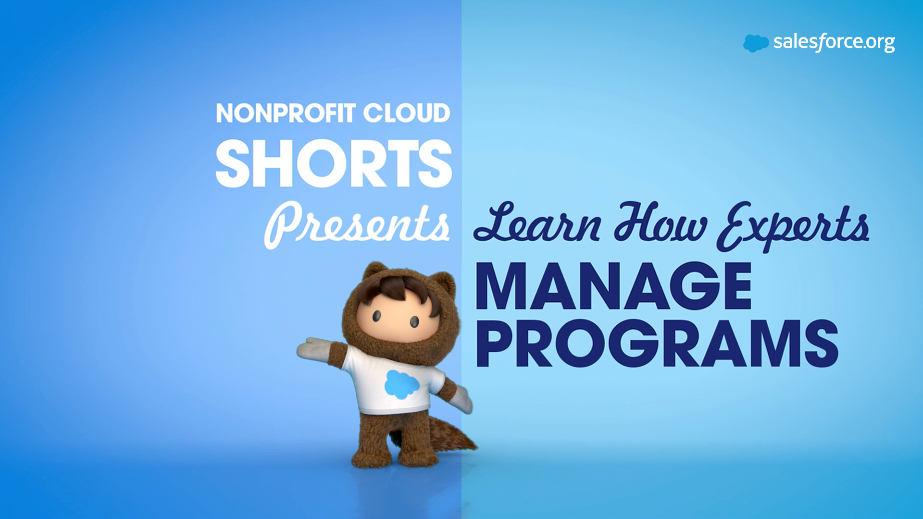

PMM Use Cases
PMM’s flexible architecture can be customized to fit many different program types.

Slide 5
Agenda
1
Programs and Services
4
Reports and Dashboards
2
Program Engagements & Cohorts
5
Next Steps
3
Service Deliveries

Slide 6
Map Programs and Services
Learning Objectives:
Learn how programs and services translate to records in Salesforce
Learn how programs and services are connected
Part 1

Slide 7
What’s the difference between a program and a service?
Programs
Services
Programs are thematic groupings that consist of one or more services.
Services are the activities that make up your programs and how you measure what you do.

Slide 8
There can be many services within a program
Service
Service
Service
Service
Service
Service
Service
Service
Service
Service
Program
Program
Program

Slide 9
Example: STEPS Programs and Services
STEPS is a human-services nonprofit that assists people experiencing poverty
STEPS offers three programs:
• Job Readiness
• Housing Assistance
• Food Services
Within the Job Readiness Program, STEPS offers two services:
• Workplace Readiness
• Computer Skills
Workplace Readiness
Computer Skills
Placement
Job Readiness Program
Rent Subsidy
Security Deposit Assistance
Housing Assistance Program
Grab & Go Meal
Food Pantry
Gift Card
Grocery Delivery
Meal Planning Class
Food Services Program
Within each program there can be a different number of services provided.

Slide 10
Map Your Programs
What programs does your organization run?

Slide 11
Program Mapping Framework
When mapping your programs, provide a clear description and goals for each
Program Name:
Housing Assistance
Description:
Provide housing subsidies for families with children under the age of 18
Goals:
Enroll 30 families by February; Distribute $50K in subsidies each month
Program Name:
Job Readiness Description:
Assist adults who have experienced an absence from the workforce
Goals:
Provide workforce exposure to 30 adults every month
Program Name:
Food Services
Description:
Provide meals and groceries to households and individuals
Goals:
Provide 100 meals every day; Deliver groceries to 300 families a month

Slide 12
Questions to Consider When Mapping Programs
What are the annual measurements and goals for this program?
What do your donors, board of directors, and others want to know about this program?
What reports do you need to run on this program?
What data do you wish you had related to this program?

Slide 13
Your turn! Map your programs here
Copy this slide to add more programs as needed
Program Name:
Description:
Goals:
Program Name:
Description:
Goals:
Program Name:
Description:
Goals:

Slide 14
Map Your Services
Now that you’ve identified your programs, let’s map the services for each.

Slide 15
Service Mapping Framework
When considering the services you offer, think about what activities your organization runs and how you measure success.
Program Name: Housing Assistance
Description: Provide housing subsidies for families with children under the age of 18
Goals: Enroll 30 families by February; Distribute $50K in subsidies each month
Service Name: Monthly Rent Subsidy
What are you tracking/measuring? Dollars

Slide 16
Questions to Consider When Mapping Services
What activities do staff provide to participants as part of a program?
How do you measure that you have achieved your program goals?
What activities do you need to track to report to donors and other stakeholders?

Slide 17
Example: STEPS Services
Map services within each program
Program Name: Housing Assistance
Program Goals: Enroll 30 families by Feb, 2022; Distribute $50K in subsidies each month
Program Name: Job Readiness
Program Goals: Provide workforce exposure to 30 adults every month
Program Name: Food Services
Program Goals: Provide 100 meals everyday; deliver groceries to 300 families a month
Service Name: Monthly Rent Subsidy
Measured By: Dollars
Service Name: Job Interview Training
Measured By: Hours
Service Name: Grocery Delivery
Measured By: Grocery Boxes Delivered
Service Name: Computer Skills
Measured By: Hours
Service Name: Grocery Store Gift Card
Measured By: Dollars

Slide 18
Your turn! Map your services here
Copy this slide to add more services as needed
Program Name:
Description:
Goals:
Program Name:
Description:
Goals:
Program Name:
Description:
Goals:
Service Name:
Measured By:
Service Name:
Measured By:
Service Name:
Measured By:
Service Name:
Measured By:
Service Name:
Measured By:
Service Name:
Measured By:

Slide 19
Review your program and services mapping
Now it’s time to sit down with your team and review your mapping to identify gaps.
This mapping will be your blueprint for entering program and service information into Salesforce.
Once your team agrees, move on to the next activity!
Get feedback before moving on

Slide 20

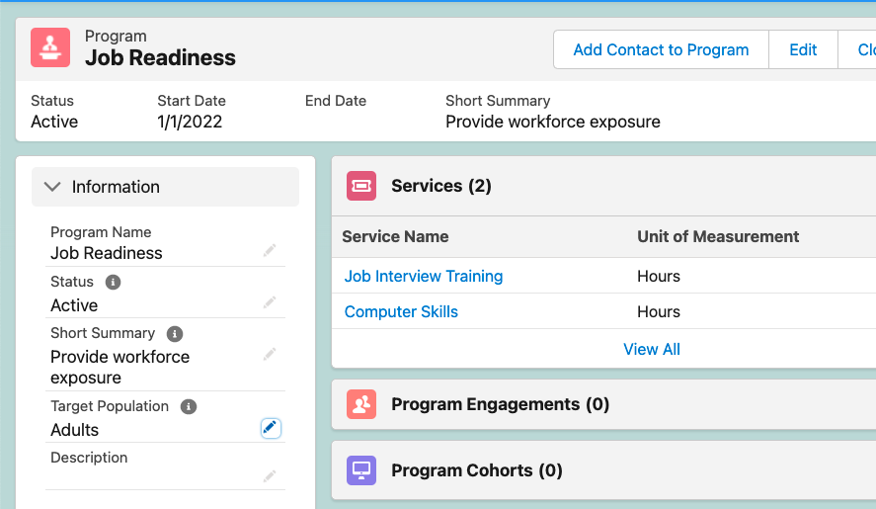





How will this look in Salesforce?
Your programs and services will look something like this once entered into Salesforce.

Slide 21
Map Program Engagements and Program Cohorts
Part 2
Learning Objectives:
Understand how program engagements connect participants to programs
Learn how program cohorts group program engagements

Slide 22
What is a program engagement?
Program engagements track the relationship between your participant and programs.
These records track participants through their entire engagement with a program—from application through participation and on to program completion—making it easy to see their full experience.
Stacy’s Job Readiness Program Engagement
Program
Contact

Slide 23
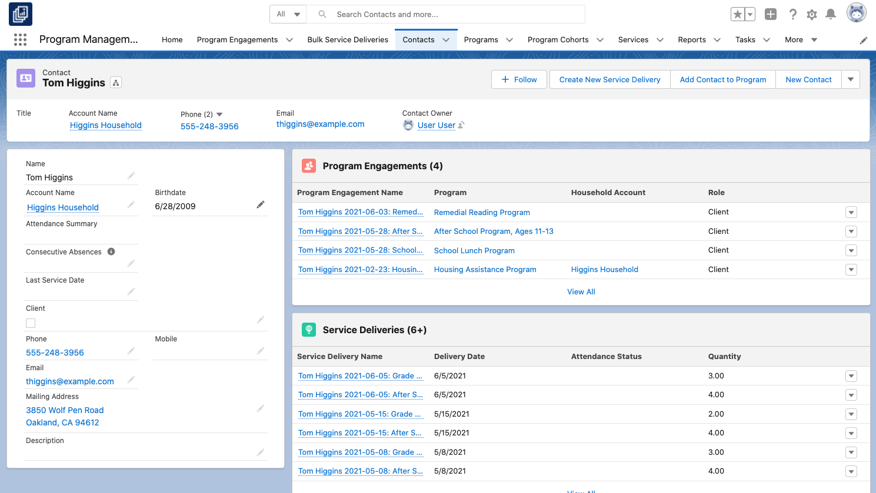
Program engagements can track multiple programs for an individual participant
If one participant is enrolled in multiple programs they will have multiple program engagement records. This provides a more complete picture of their program involvement, and makes both reporting and program delivery easier.
Here you can see that Tom is enrolled in a remedial reading program and a school lunch program.
These two programs are run by different teams and Tom enrolled in them at different times.

Slide 24
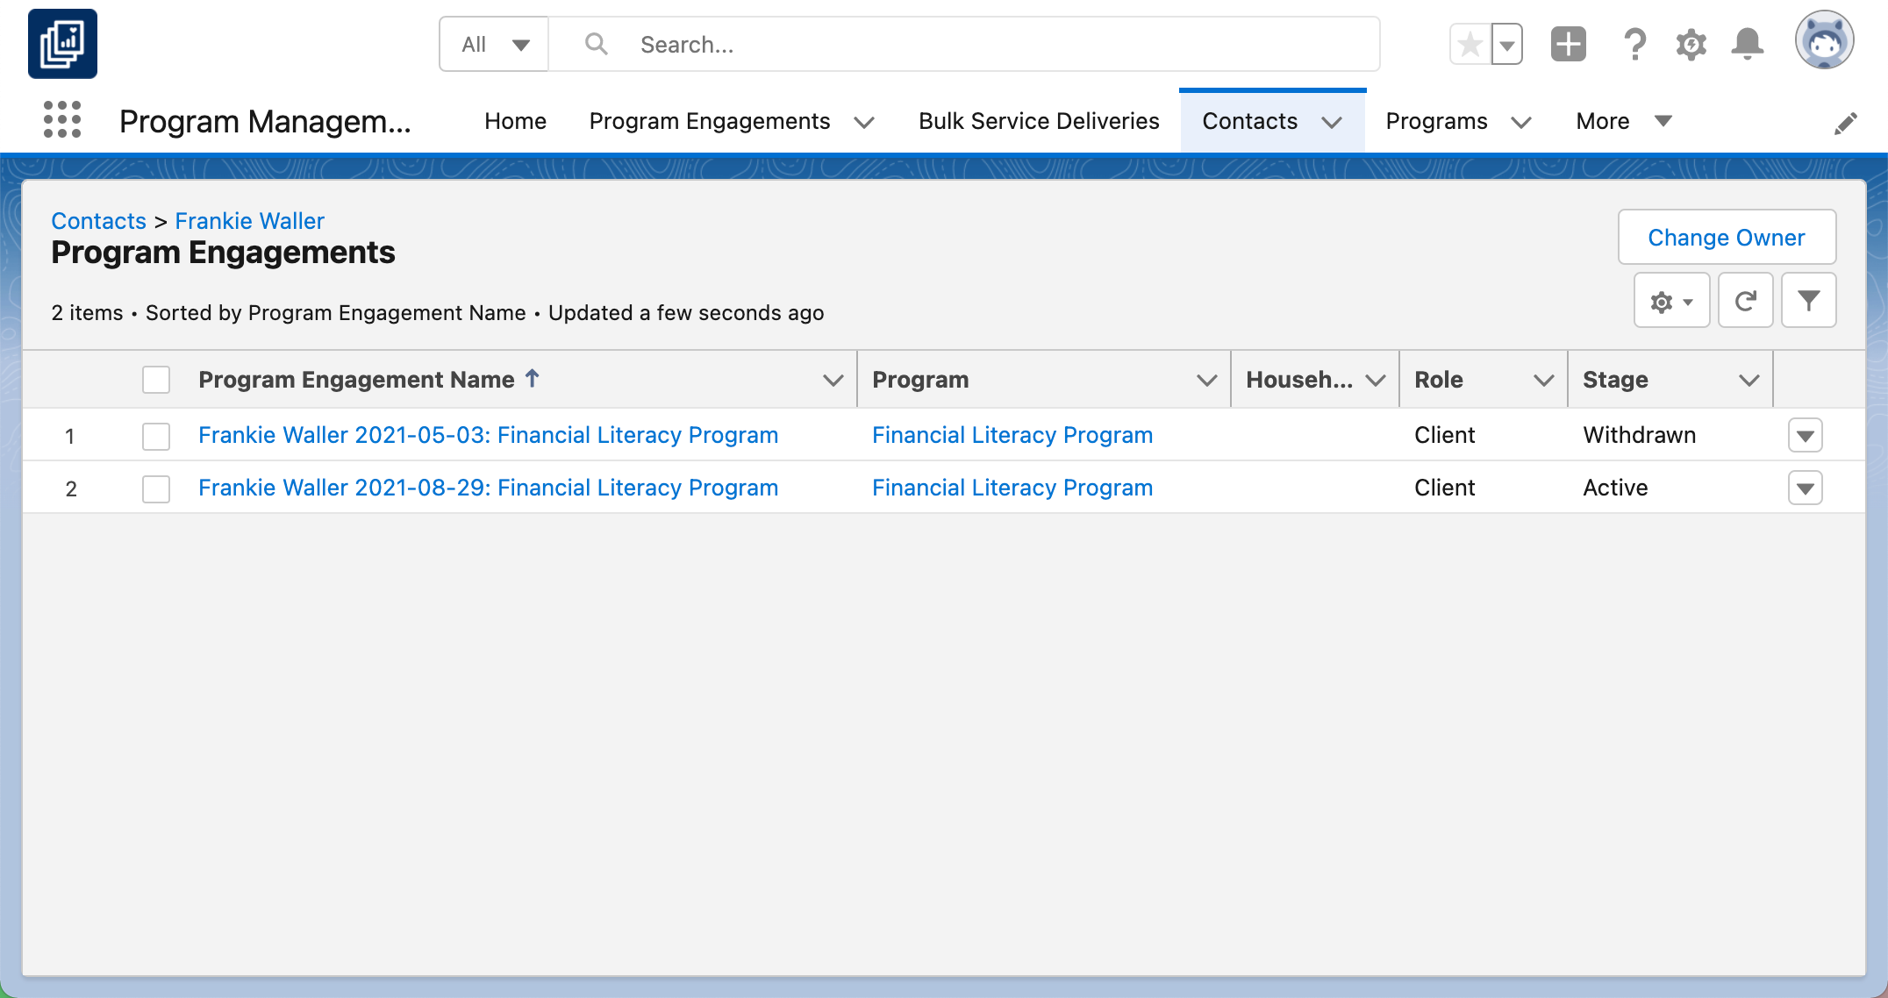
Program engagements can track re-engagement
Program engagements can also record exactly when a participant engages, disengages, or re-engages with a program.
For example, Frankie has an existing program engagement record that shows they previously enrolled to attend a class, but had to withdraw before they could receive services.
If Frankie applies again, this information may be useful for program staff.

Slide 25
Who are your program participants?
Organization or Household
Individual Person
A participant is often an individual person (recorded in the Contact object in Salesforce).
In this case the program engagement record links the contact to the program.
A participant may also be an organization or household (recorded as an Account object in Salesforce) or some other entity—like a park or an animal—that will need to be recorded in a custom object.
If your participants are not people, follow the instructions in the Set Up Organization Accounts or Custom Objects for more information on setting this up.
Stacy’s Job Readiness Program Engagement
Program
Contact
Program
Washington High School Program Engagement
Account

Slide 26
Program Engagement Examples
Individuals vs. Organizations
Program Name: Career Counseling Program 2022-2023
Program Name: School Supplies Distribution Program
Program Engagement Name*: Tommy’s Career Counseling Program 2022-2023
Participant: Individual
Representative Object in Salesforce: Contact
Program Engagement Name*: Washington High School Supply Distribution 2022
Participant: School
Representative Object in Salesforce: Account
Program Engagement Name: Robin’s Career Counseling Program 2022-2023
Participant: Individual
Representative Object in Salesforce: Contact
Program Engagement Name: Lincoln High School Supply Distribution 2022
Participant: School
Representative Object in Salesforce: Account
* Note: Program Engagement names can be customized and automated. For more information see the Customize Naming for Program Engagements and Service Deliveries product documentation.

Slide 27
Your turn! Map your program engagements here
Copy as many boxes as you need
Program Name:
Program Name:
Program Engagement Name:
Participant:
Representative Object in Salesforce:
Program Engagement Name:
Participant:
Representative Object in Salesforce:
Program Engagement Name:
Participant:
Representative Object in Salesforce:
Program Engagement Name:
Participant:
Representative Object in Salesforce:

Slide 28
Map Program Cohorts
Program engagements can be grouped into program cohorts to streamline reporting.
Program cohort records represent groups of engagements, such as all of the engagements at one service location, in the same service period or program cycle, or using the same curriculum.
Using program cohorts makes it easy to report on a group of engagements using just one record.

Slide 29
Program Cohort Examples
STEPS
School Success First
STEPS runs its job readiness program three times a year. The organization serves a different group of people each time.
When they talk about these groups internally STEPS staff refer to the groups by the season and year:
• Spring 2022 Cycle
• Summer 2022 Cycle
• Fall 2022 Cycle
School Success First is an organization that distributes school supplies. It runs its school supplies distribution program in three locations across several different towns.
School Success First creates cohorts based on location:
• East Bay Schools
• North Bay Schools
• San Francisco Schools
Note: A program engagement can only be associated with one program cohort. Hierarchies are not included by default with PMM, but could be created using lookup fields.

Slide 30
Questions to Consider When Mapping Program Cohorts
When you talk to your colleagues about program participants, what groupings do you refer to?
When you report on groups of participants, what groupings do you typically use?
Are there any common groupings—such as region, date, cycle, or school grade—that make sense in your context?

Slide 31
Program Engagement and Program Cohort Examples
Participant: Individuals
Program Name: Job Readiness Program
Program Cohort Name: Spring 2022 Cycle
Program Engagement Name: Bill Perkins Job Readiness
Participant: Individual
Representative Object in Salesforce: Contact
Program Engagement Name: Sara Jones Job Readiness
Participant: Individual
Representative Object in Salesforce: Contact
Program Engagement Name: Lin Yuen Job Readiness
Participant: Individual
Representative Object in Salesforce: Contact
Program Cohort Name: Summer 2022 Cycle
Program Engagement Name: Nita Singh Job Readiness
Participant: Individual
Representative Object in Salesforce: Contact
Program Engagement Name: Julio Cesar Job Readiness
Participant: Individual
Representative Object in Salesforce: Contact

Slide 32
Program Engagement and Program Cohort Examples
Participant: Accounts
Program Name: School Supplies Distribution Program
Program Cohort Name: East Bay Schools
Program Engagement Name: Washington High School
Participant: School
Representative Object in Salesforce: Account
Program Engagement Name: Westside High School
Participant: School
Representative Object in Salesforce: Account
Program Engagement Name: Bayhill High School
Participant: School
Representative Object in Salesforce: Account
Program Cohort Name: North Bay Schools
Program Engagement Name: Hillside High School
Participant: School
Representative Object in Salesforce: Account
Program Engagement Name: Emerson Elem. School
Participant: School
Representative Object in Salesforce: Account

Slide 33
Your turn! Map your program cohorts and program engagements
Program Name:
Program Cohort Name:
Program Engagement Name:
Participant:
Representative Object in Salesforce:
Program Engagement Name:
Participant:
Representative Object in Salesforce:
Program Cohort Name:
Program Engagement Name:
Participant:
Representative Object in Salesforce:
Program Engagement Name:
Participant:
Representative Object in Salesforce:

Slide 34
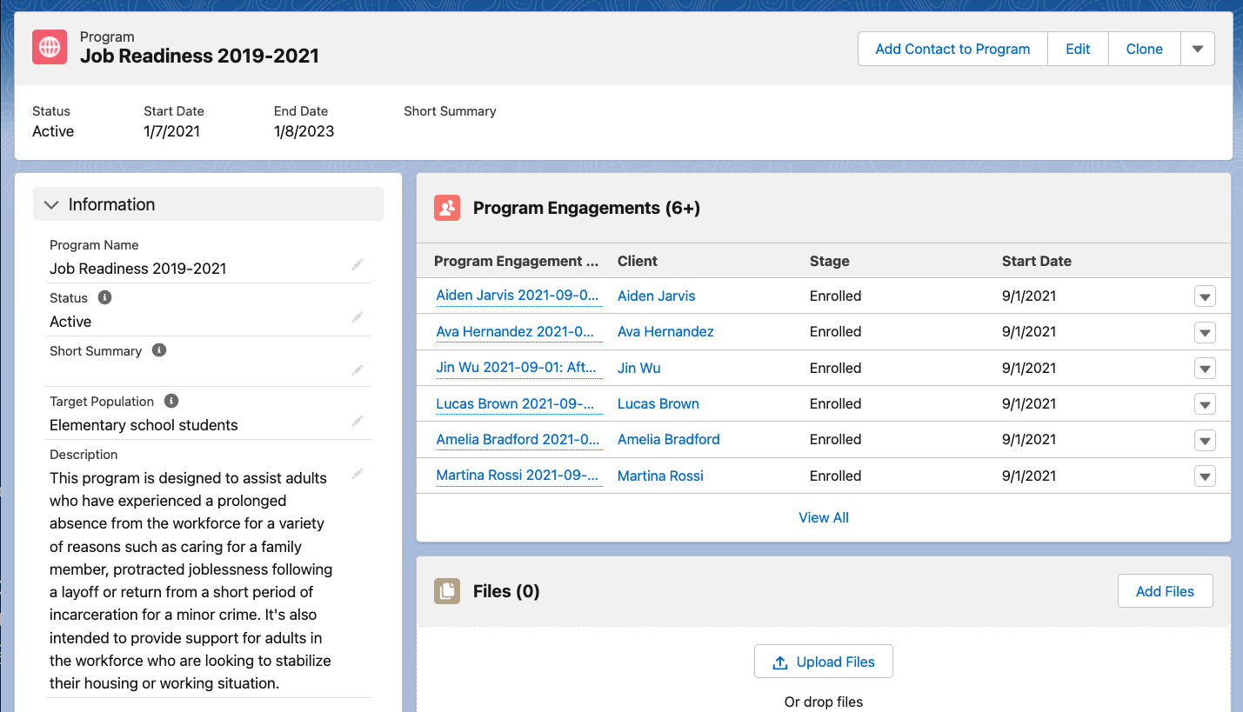
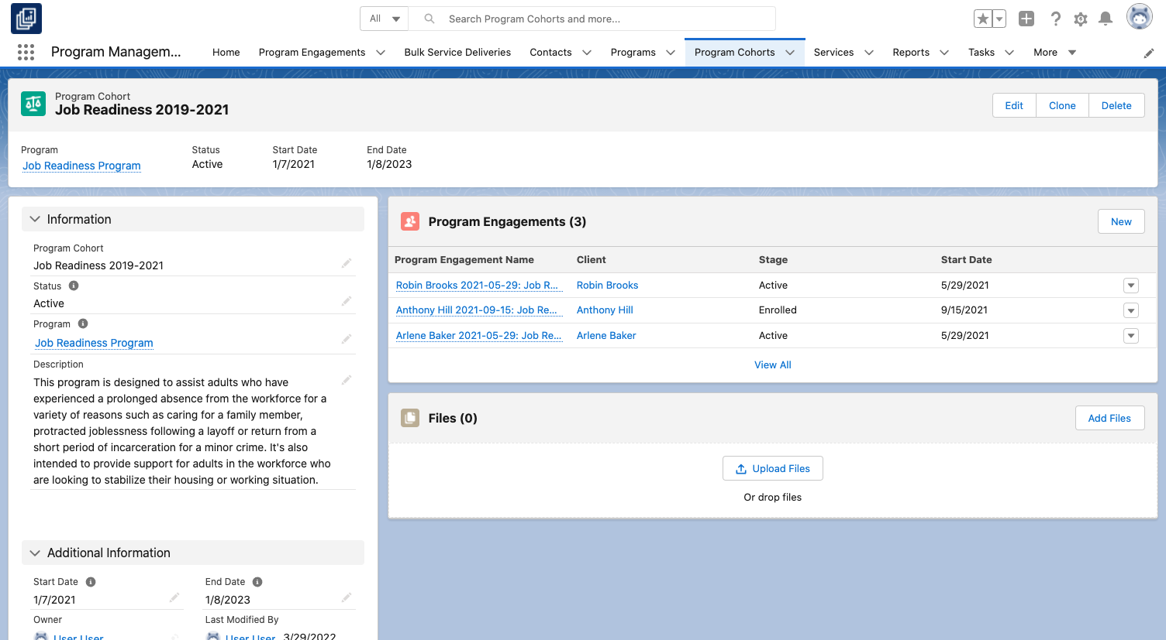
How will this look in Salesforce?
Program Engagements within a Program
Program Engagements within a Cohort

Slide 35
Review your program engagement and cohort mapping
Now it’s time to sit down with your team and review the mapping collectively to identify gaps.
Once your team agrees, move on to the next activity!
Get feedback before moving on

Slide 36
Capture Your Service Deliveries
Learning Objectives:
Understand the different ways a service delivery record is created.
Apply the right service delivery creation method for different situations.
Part 3

Slide 37
What is a service delivery?
Service delivery records represent a specific instance of a service activity, including the recipient of the service, when they received the service, and how much was delivered.
These records can be viewed on program engagement and participant (contact, account, etc.) records.
Program
Housing Assistance Program
Service
Service Delivery
Monthly Rent Subsidy
Tim's Feb 2022 Monthly Rent Subsidy

Slide 38
Service Delivery Scenarios
Different scenarios require different tools
Individual Service Delivery
Capture attendance or recurring service deliveries.
Capture a group of non-recurring service deliveries.
Capture a single non-recurring service delivery.
Attendance Tracking from Service Schedule
Capture Service Deliveries in Bulk

Slide 39
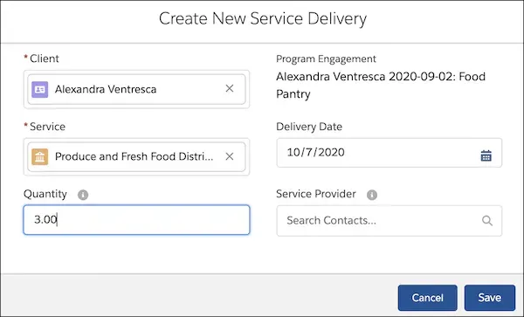
Individual Service Delivery
Create a single or one-off services from a program engagement record
Use the Create New Service Delivery action on the program engagement record to create a single service delivery record.

Slide 40
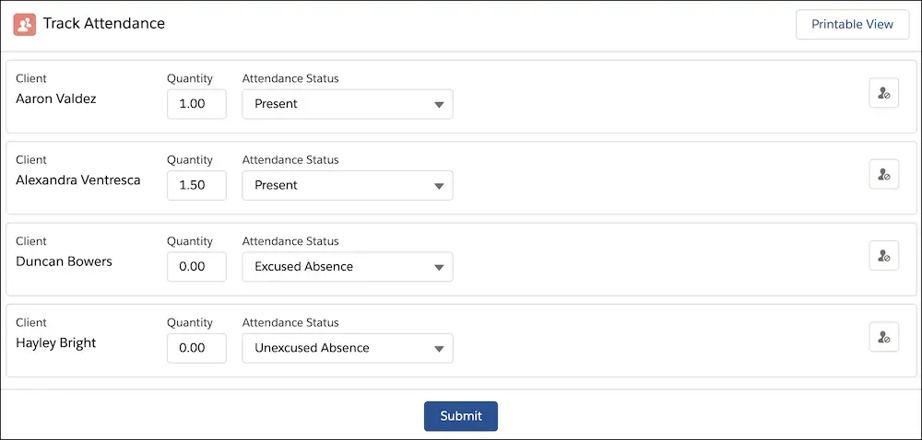
Service Schedule Attendance
Update attendance or recurring service deliveries in a convenient printable form
Create Service Schedules for one-time or recurring events for groups such as classes, mentoring sessions, or community events.

Slide 41
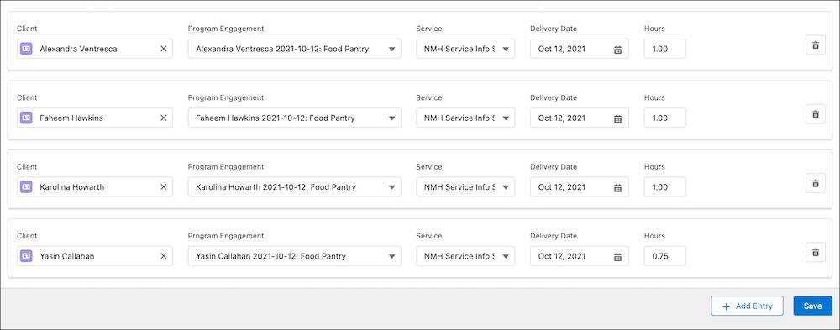
Bulk Service Deliveries Tab
Capture a group of non-recurring service deliveries
Use Bulk Service Deliveries to create multiple service deliveries at once, either by group or individual, such as drop-ins at a job training workshop or grocery gift cards given to an individual.

Slide 42
Decide which service delivery creation tool to use
 | Supports
Tool | Scheduled sessions | Know participants in advance | More than one participant
Individual service delivery record | 🚫 | 🚫 | 🚫
Bulk service delivery | 🚫 | 🚫 | ✅
Service schedules and attendance tracking | ✅ | ✅ | ✅

Slide 43
Service Delivery Framework Examples
Service/Activity Name | Is it recurring? | Do you know the roster of participants in advance? | Do you track attendance of specific individuals? | How many clients are you serving at one time? | Who leads? | Who is recording the service delivery? | What’s the best way to create service deliveries?
Parent Support Groups | Yes, Weekly | Yes | Yes | 20 Clients | Program Manager | Program Manager | Service Schedules and Attendance Tracking
Family Workshops | Yes, Monthly | No | Yes | 30 Clients | Whole Programs team | Program Coordinator | Bulk Service Delivery
1:1 Parenting Coaching | No | Yes | Yes | 1 Client or Household | Counselor | Counselor | Individual Service Delivery

Slide 44
Your turn! Capture your service delivery mapping
Service/Activity Name | Is it recurring? | Do you know the roster of participants in advance? | Do you track attendance of specific individuals? | How many people are you recording for? | Who leads? | Who is recording the services that happened? | What’s the best way to track this service?

Slide 45
Review your service mapping
Review the mapping with your team and identify potential gaps. This mapping will be your blueprint for entering service deliveries in Salesforce.
Once your team agrees, move on to the next activity!
Get feedback before moving on

Slide 46
Reports and Dashboards
Learning Objectives:
Get the most out of PMM’s out-of-the-box reports
Extract meaningful data and share with your stakeholders
Part 4

Slide 47
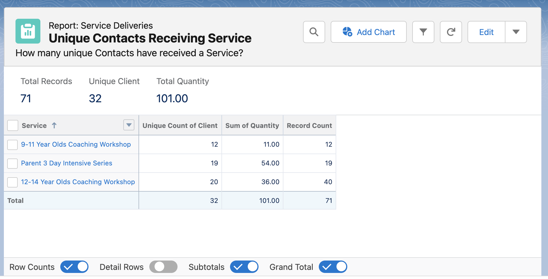
Program Management Reporting
Get real-time information about program performance
PMM comes with a variety of reports out-of-the-box (some of them listed below). You can make copies of these reports, filter them to include only the programs you manage, and add them to your personal dashboard so you can track program performance in real time.
• Client Enrolled this Month by Program
• Clients Enrolled This Month
• Services Delivered (Year to Date)
• Units Delivered Over the Last 6 Months
• Service Deliveries by Provider Last Month
• Contacts with 3 Consecutive Absences
• Contact Records Missing Phone Numbers
• Contact Records Missing Email
• All Active Program Engagements
• All Program Engagements by Stage
PMM Reports & Dashboards Documentation

Slide 48
Think through how to get the data you want
Consider these two scenarios. Who is is viewing the dashboard and what are they trying to do?
Scenario 1
Scenario 2
A program director is preparing next year’s annual plan. What do they want to see about how their programs performed last year to help plan for next year?
The executive director and a program director ask you to run reports for them all the time. Which reports could you put in a dashboard so they can regularly access them without your help?

Slide 49
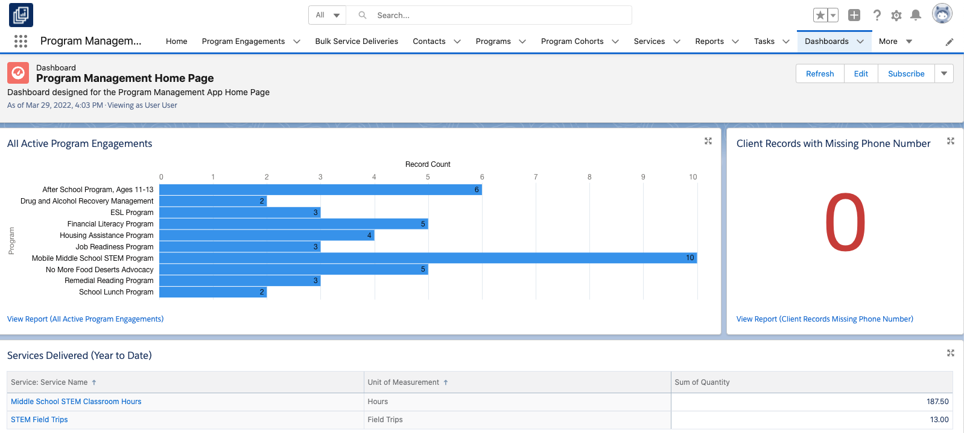
Dashboard Example
Any report can be turned into a dashboard component on your homepage, giving you the information you need at your fingertips

Slide 50




Your turn! Map out your dream dashboard
Using a whiteboard or pen and paper, write down what your ideal dashboard would look like!
Component Type |  | Use Case | Example | Your Needs
 | Chart | Display data graphically | Percentage of services that make up a program
 | Gauge | Display a single value among a range | Progress towards a defined annual service goal
 | Metric | Display one key value | Total clients served this year
 | Table | Display report data in a column form | Top 20 services provided
Source: help.salesforce.com/s/articleView?id=sf.dashboards_component_types.htm&type=5

Slide 51
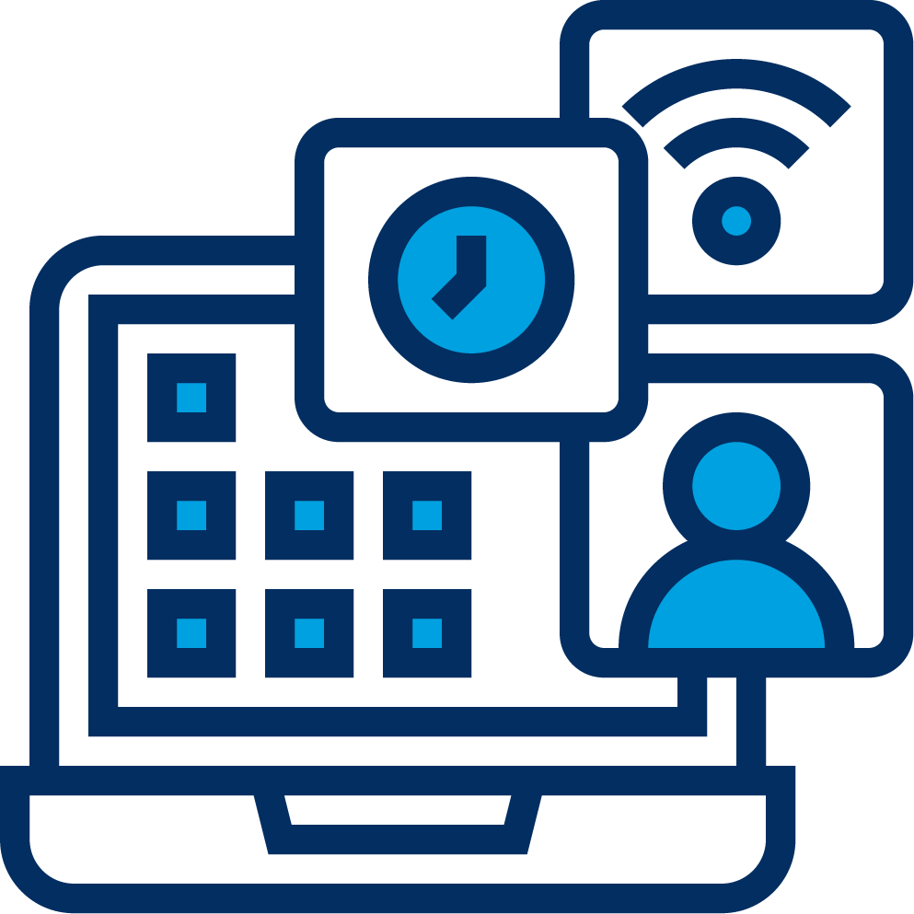


Next Steps
Check Out Resources
Videos:
Create Programs and Services
Work with Individuals
Work with Groups
Trailhead:
Program Management with Nonprofit Cloud
Get Hands-on Training
Get hands-on experience with PMM in the monthly Base Camp webinar: Program Management Basics
Engage with the Community
Ask questions and get answers from other organizations using PMM in the Program Management Module group in the Trailblazer Community

Slide 52


